Slide 1
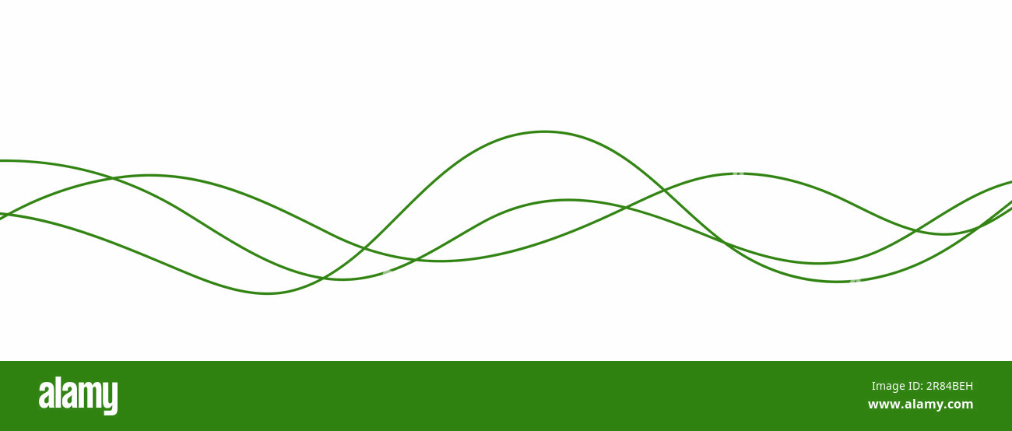
Quantum Internet Infrastructure
qAIntum.ai
qAIntum.ai
Quantum Large Language Model Company
Sophie Choe, Founder
July 23, 2024
Confidential. Do not distribute.

Slide 2
AGENDA
Quantum Communications
Quantum Computing
Quantum Memory
Quantum Transducers
Quantum Sensing
Conclusion and Q&A
Advancing Humanity through Quantum Innovations
Confidential. Do not distribute.

Slide 3
Quantum InterConnects
Quantum computers are not going to replace classical computers.
They are going to be application-specific computers solving specific problems.
They will be used as special purpose computers in the classical computing paradigm.
National Science Foundation (NSF) and Department of Energy (DOE) have been designing a blueprint for the classical-quantum hybrid internet infrastructure since 2019.
It will utilize the existing communications-computing infrastructure with additional channels for quantum information processing.
Development of Quantum InterConnects (QuICs) for Next-Generation Information Technologies
Confidential. Do not distribute.

Slide 4
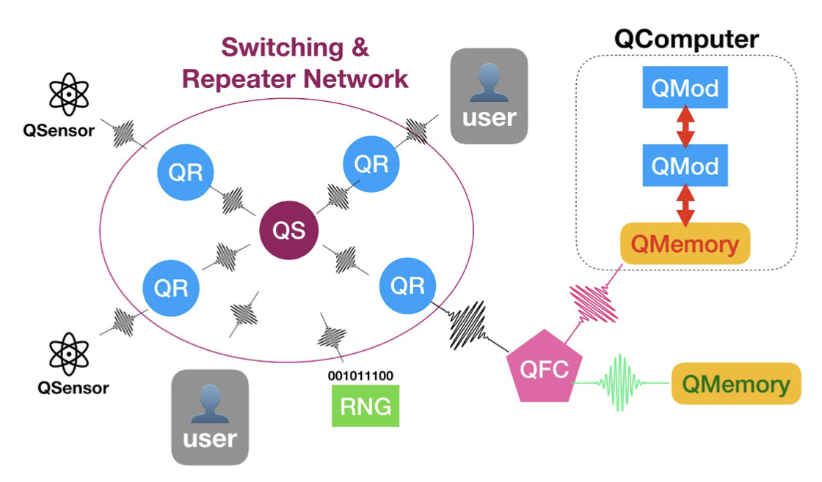
Components of Quantum InterConnects
Quantum InterConnects
Quantum communications
Quantum computers
Quantum memory
Transducers
Quantum sensors
Development of Quantum InterConnects (QuICs) for Next-Generation Information Technologies
Confidential. Do not distribute.

Slide 5
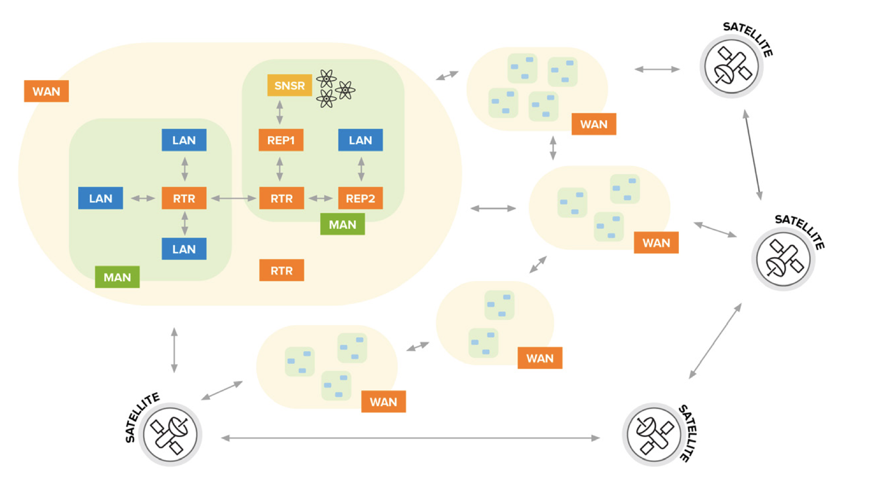
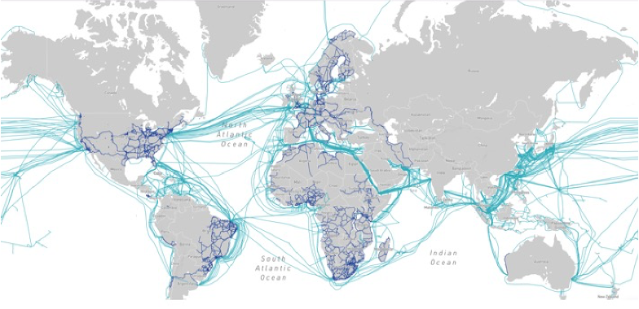
Quantum Internet Infrastructure
Fully realized quantum network
SAT
WAN
MAN
LAN
submarine fiber optics network
A Roadmap for Quantum Interconnects, Q-Next, DOE Office of Science National Quantum Information Science Research Centers, July 2022,
Confidential. Do not distribute.

Slide 6
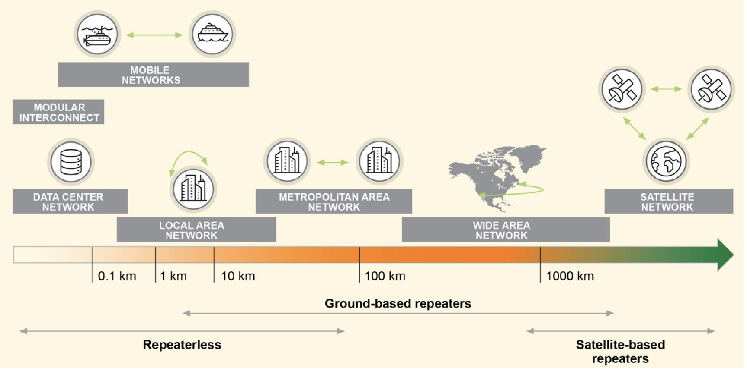
Quantum Communications
submarine fiber optics network
A Roadmap for Quantum Interconnects, Q-Next, DOE Office of Science National Quantum Information Science Research Centers, July 2022,
Confidential. Do not distribute.

Slide 7
Classical-Quantum Hybrid Network
Quantum Network will share the existing Fiber Optics communications infrastructure.
submarine fiber optics network
Advancing Humanity through Quantum Innovations
Confidential. Do not distribute.

Slide 8
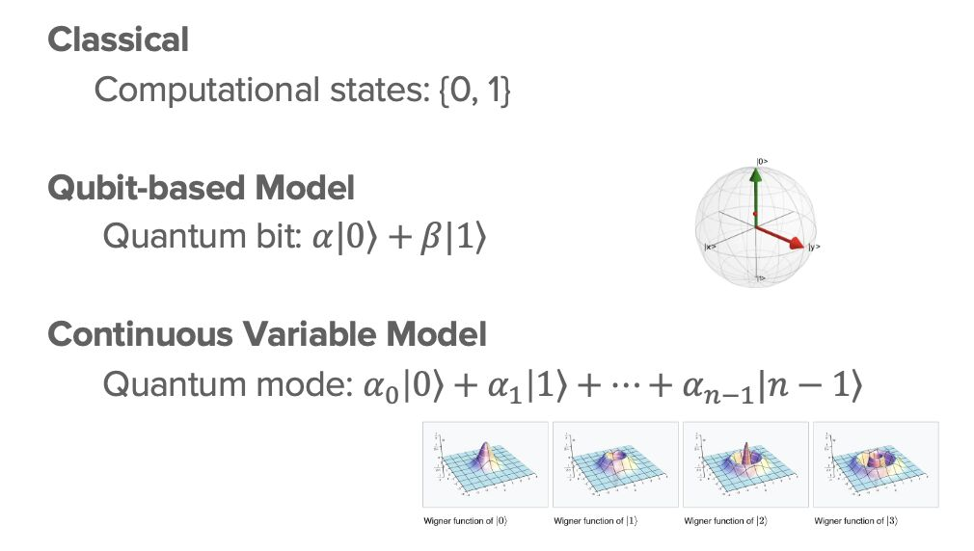
Quantum Computing
SUPERPOSITION
Inherent Parallelism
because of
the higher dimensional
computational space
+
Simultaneity of states.
QLLM Accelerator
Photonic Quantum Processing Units
as High Performance Computing
Advancing Humanity through Quantum Innovations
Confidential. Do not distribute.

Slide 9
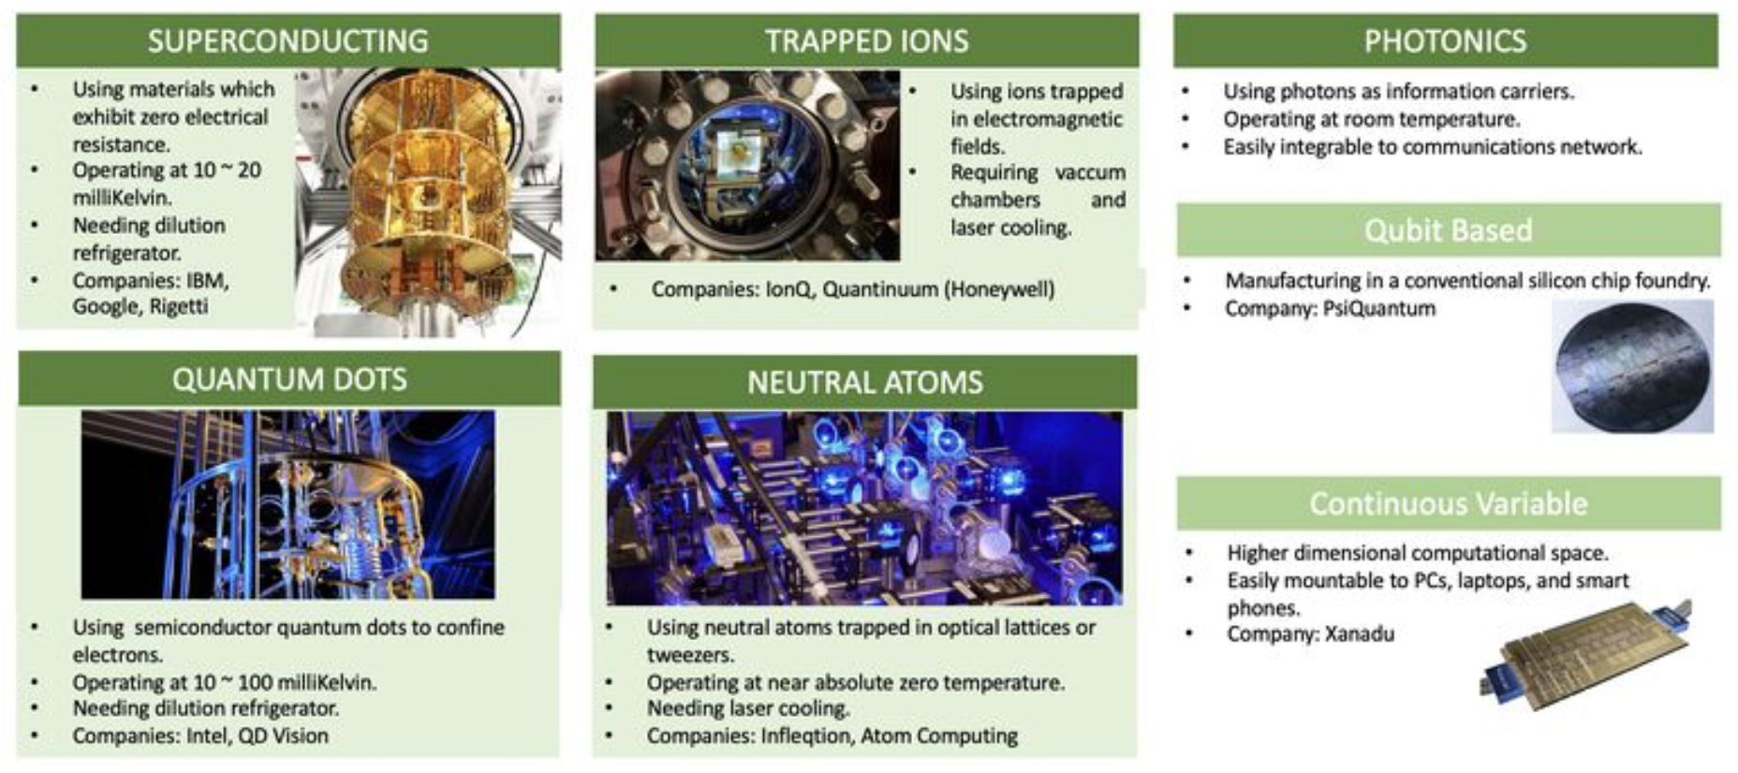


Physical Implementation of Quantum Computing
QLLM Accelerator
Photonic Quantum Processing Units
as High Performance Computing
Quantum Internet
Quantum Communications
Quantum Memory
Quantum Sensors
Advancing Humanity through Quantum Innovations
Confidential. Do not distribute.

Slide 10
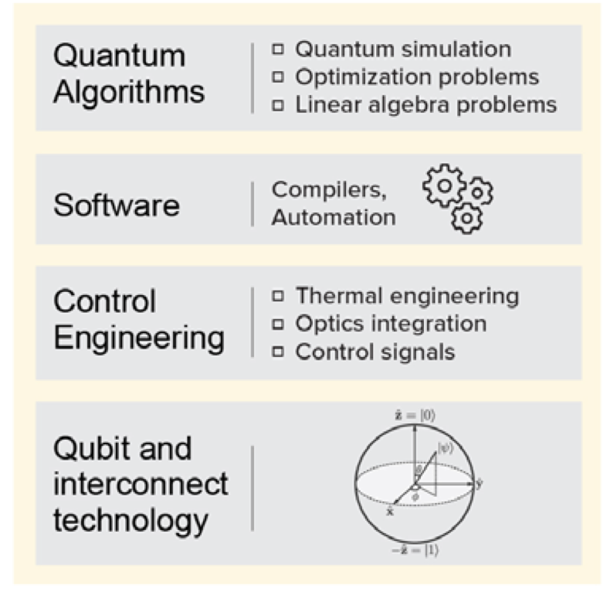
Quantum Computing Stack
In order for quantum computers to be used for practical problems, we need a full stack of
hardware
control engineering
middleware
software
quantum algorithms
A Roadmap for Quantum Interconnects, Q-Next, DOE Office of Science National Quantum Information Science Research Centers, July 2022,
Confidential. Do not distribute.

Slide 11
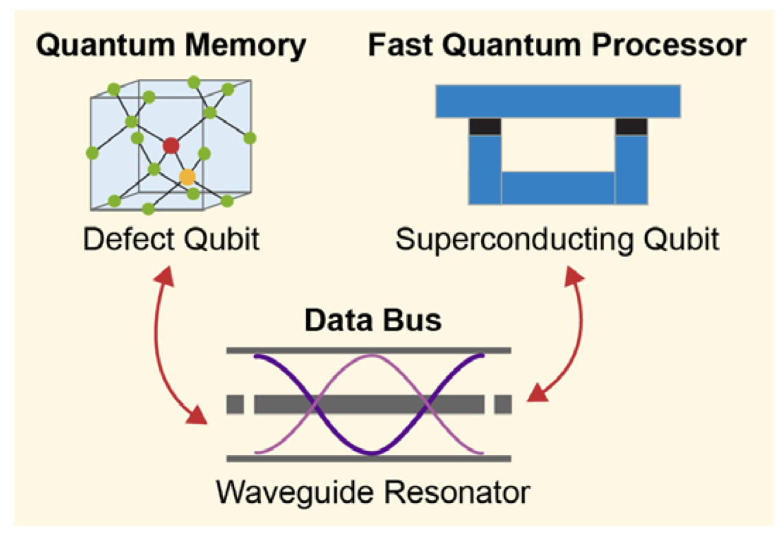
Quantum Memory
We need to store quantum information complex computations.
A Roadmap for Quantum Interconnects, Q-Next, DOE Office of Science National Quantum Information Science Research Centers, July 2022,
Confidential. Do not distribute.

Slide 12
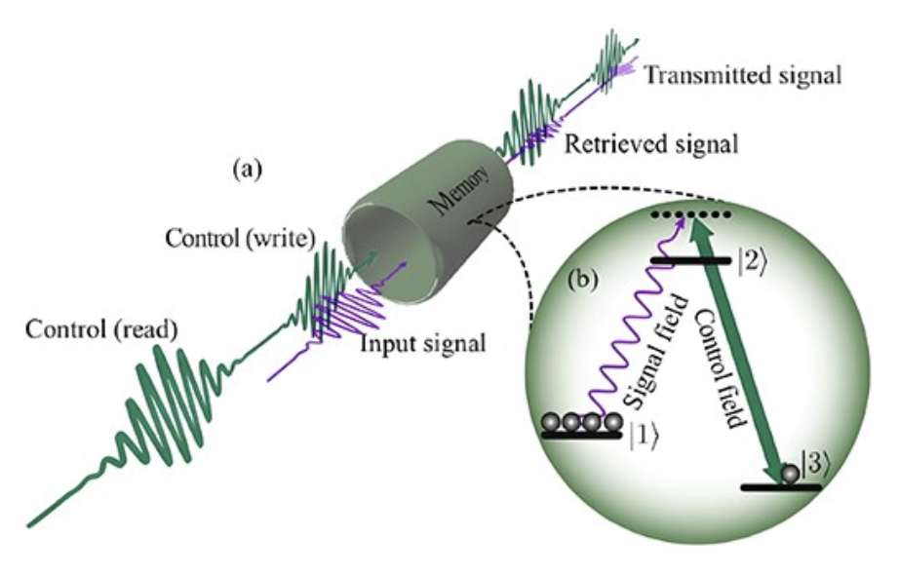
Quantum Memory
Quantum Computing:
enabling error correction
implementation of quantum algorithms that require long-term storage of quantum states.
Quantum Communication:
in quantum repeaters, which are used to extend the range of quantum communication networks.
https://www.gophotonics.com/community/what-is-a-quantum-memory
Advancing Humanity through Quantum Innovations
Confidential. Do not distribute.

Slide 13
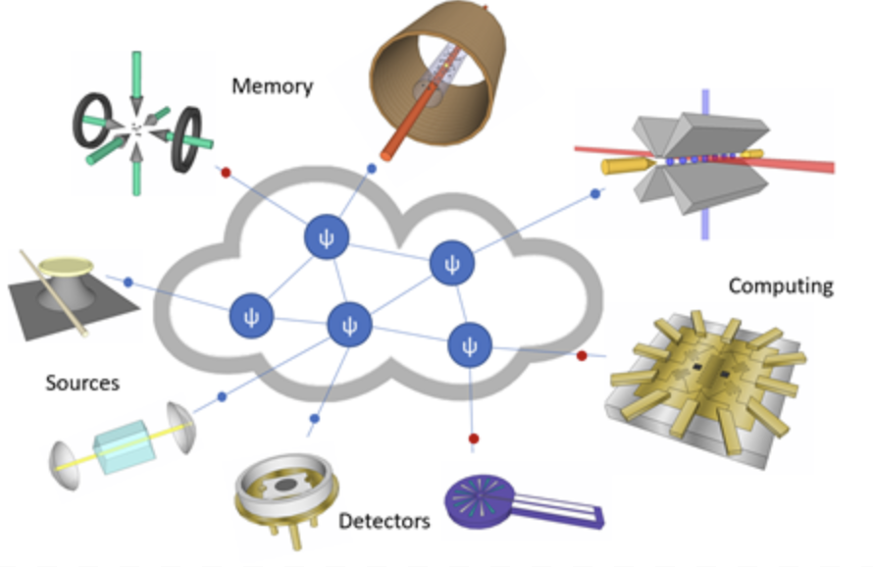
Quantum Transducers
Quantum transducers are devices that convert quantum information from one physical form to another, enabling the interconnection of different quantum systems.
https://www.nist.gov/pml/quantum-networks-nist/technologies-quantum-networks/transducers
Advancing Humanity through Quantum Innovations
Confidential. Do not distribute.

Slide 14
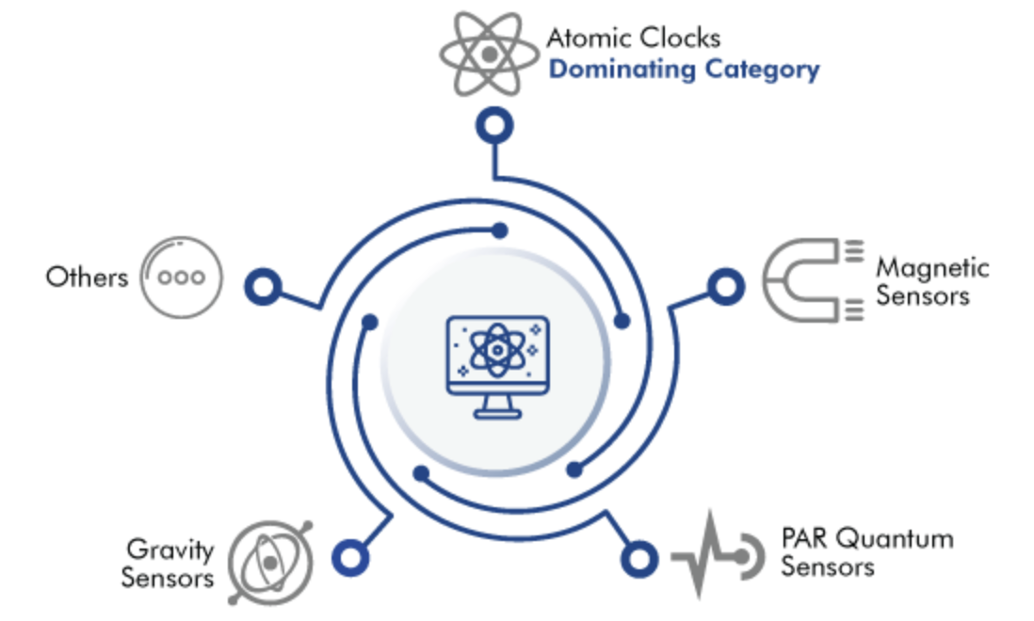

Quantum Sensing
Application Industries
Photosynthetically Active Radiation
https://www.psmarketresearch.com/market-analysis/quantum-sensors-market
Confidential. Do not distribute.

Slide 15
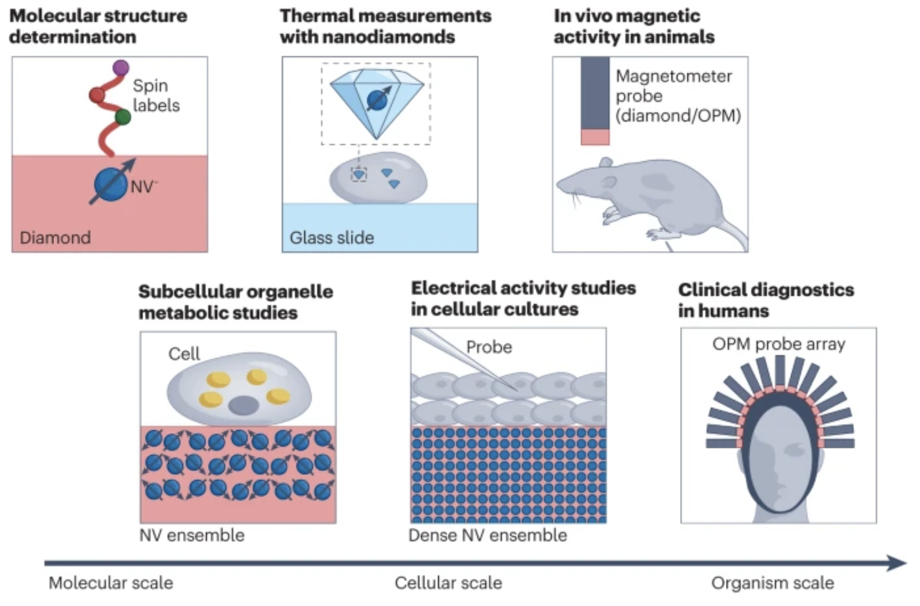
Biomedical Quantum Sensing
Quantum sensors for biomedical applications, Aslam et al., Nature Reviews Physics, 2023
Confidential. Do not distribute.

Slide 16
Photonic Analog Quantum Computing
Advantages of PAQC
Compatible with the existing communications infrastructure.
Operates at room-temperature.
Higher dimensional computational space.
Easy to network and multiplex
Low cost of mass production
Mountable on smartphones, laptops, and edge devices
qAIntum.ai believes the future of quantum computing will be Photonics-based.
Advancing Humanity through Quantum Innovations
Confidential. Do not distribute.

Slide 17
Conclusion
With 40 years of history, quantum computing is still at its infancy compared to what can be realized.
Algorithms and hardware need to be developed hand in hand.
Analog Quantum Computing offers higher dimensional computational space, hence more compression of information processing.
Photonic Quantum Computing offers the most cost effective solution with utilities.
Quantum future is arriving.
Advancing Humanity through Quantum Innovations
Confidential. Do not distribute.

Slide 18
Quantum Future is Coming!
Thank you!
Advancing Humanity through Quantum Innovations
Confidential. Do not distribute.

